Slide 1
Healthy Churches COUNTER FALSE TEACHING
1 Timothy 4:11-16
Preached by Dr. Jim Harmeling at Crossroads International Church Singapore • cicfamily.com Uploaded by Dr. Rick Griffith • Singapore Bible College Thousands of files in 49 languages for free at BibleStudyDownloads.org

Slide 2
Who is your favorite detective?

Slide 3
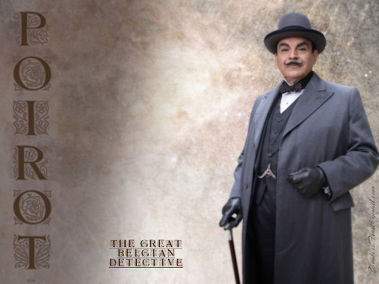

Slide 4
Healthy Church Life
Studies in 1 Timothy

Slide 5
Healthy Churches discern Truth from error
1 Timothy 4:1-16

Slide 6
Satan’s strategies for destroying Christ’s church
Persecute it
Divide it
Poison it

Slide 7
1 Timothy 4:4-5
For everything created by God is good, and nothing is to be rejected if it is received with thanksgiving, for it is made holy by the word of God and prayer.

Slide 8
Libertine
Take from the Bible
Legalist
Add to Bible
Enjoy life
Holy life
False teachers on the left and right

Slide 9
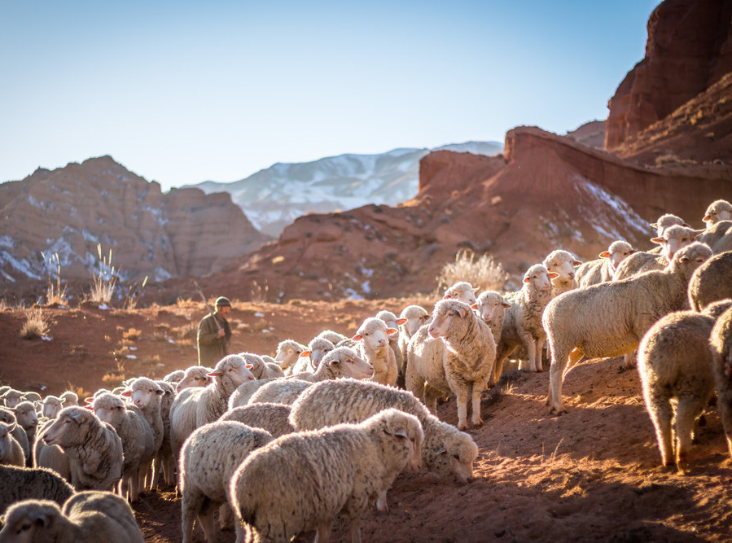
Healthy churches are alert to various attacks on the gospel (1 Tim 4:1-5)
Healthy churches counter the influence of false teaching (1 Tim 4:6-10)
The congregation is alert to false teaching (v. 6)
They are careful not to be gullible (v. 7a)
They pursue godliness (vs. 7b-10)
They nurture spiritual maturity in young people (vs. 11-12)
speech – conduct – love – faith – purity

Slide 10
3 John 3
“I have no greater joy than to hear that my children are walking in the truth”

Slide 11
Healthy churches are alert to various attacks on the gospel (1 Tim 4:1-5)
Healthy churches counter the influence of false teaching (1 Tim 4:6-10)
The congregation is alert to false teaching (v. 6)
They are careful not to be gullible (v. 7a)
They pursue godliness (vs. 7b-10)
They nurture spiritual maturity in young people (vs. 11-12)
They provide regular opportunities to study the truth of Scripture (v. 13)

Slide 12
Bible Basics
Bible
God
Jesus
Holy Spirit
Sin Salvation

Slide 13
Healthy churches are alert to various attacks on the gospel (1 Tim 4:1-5)
Healthy churches counter the influence of false teaching (1 Tim 4:6-10)
The congregation is alert to false teaching (v. 6)
They are careful not to be gullible (v. 7a)
They pursue godliness (vs. 7b-10)
They nurture spiritual maturity in young people (vs. 11-12)
They provide regular opportunities to study the truth of Scripture (v. 13)
They develop people in leadership (vs. 14-16)

Slide 14
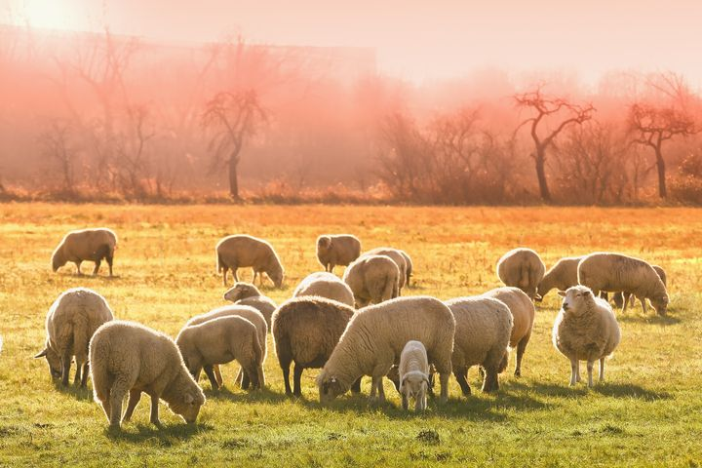
“Do not neglect”

Slide 15
Acts 13:1-3
¹ Now there were in the church at Antioch prophets and teachers, Barnabas, Simeon who was called Niger, Lucius of Cyrene, Manaen a lifelong friend of Herod the tetrarch, and Saul. ² While they were worshiping the Lord and fasting, the Holy Spirit said, “Set apart for me Barnabas and Saul for the work to which I have called them.” ³ Then after fasting and praying they laid their hands on them and sent them off.

Slide 16
“Do not neglect”
“Practice these things”

Slide 17
“Paul’s purpose in the appeal was for Timothy to make a powerful demonstration of the spiritual advance since his earlier years. If Timothy obeyed Paul’s advice, his friends in Ephesus would not see him an inexperienced youth but as a growing man of God. Church members will follow someone whom they respect when the mere authority of the office makes them react or resist.”
Thomas Lea

Slide 18
“Do not neglect”
“Practice these things”
“Keep close watch”

Slide 20
NT Preaching • BibleStudyDownloads.org
Get this presentation for free!

